Slide 1
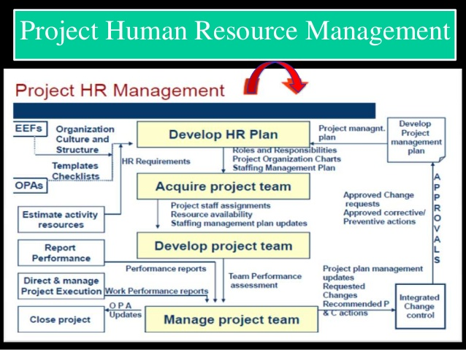

Slide 2
Project HRM Overview
The process of identifying and documenting project roles, responsibilities, required skills, reporting relationships, and creating a staffing management plan.
Plan HRM
The process of confirming human resource availability and obtaining the team necessary to complete project activities.
Acquire Project Team
Develop Project Team
The process of improving competencies, team member interaction and overall team environment to enhance project performance.
Manage Project Team
The process of tracking team member performance , providing feedback, resolving issues, and managing changes to optimize project performance.

Slide 3
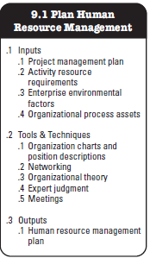
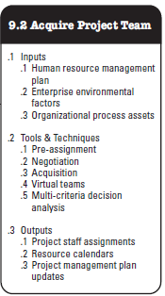
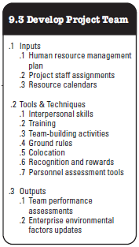
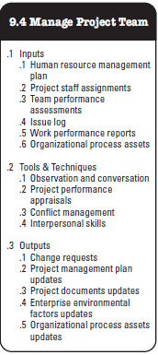
Project Human Resource Management Overview

Slide 4
Organisation Types
Functional
Organization
Project
Organization
Matrix
Organization

Slide 5
Types of Matrix Org
Strong Matrix Structure
Balanced Matrix Structure
Weak Matrix Structure

Slide 6
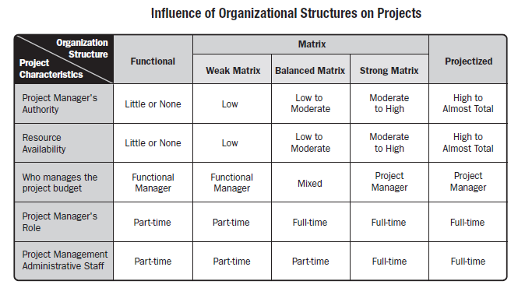
Organizational Structures

Slide 7
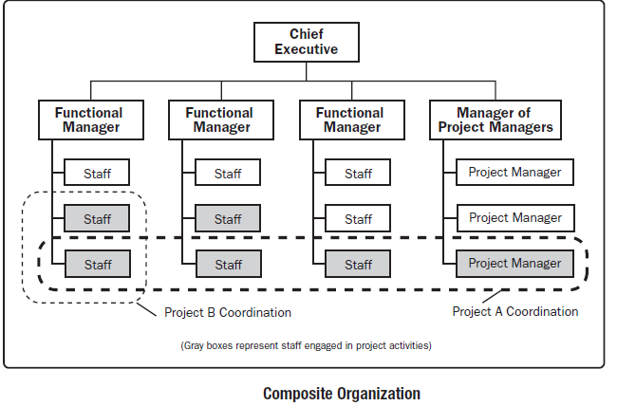
Organizational Structures
Some Organizations use a hybrid (mix) of these structures to meet their varied needs. For example, a functional organization may run a specific project just like it would be run in a projectized organization. Such organizations are called composite organizations

Slide 8
Project Stakeholders
It includes all members of the project team as well as all interested entities that are internal or external to the organization.
The project team identifies external and internal, positive & negative and performing and advising stakeholders in order to determine the project requirements and the expectations of all parties involved.
The project manager should manage the influence of these various stakeholders in relation to project requirements to ensure a successful outcome.

Slide 9
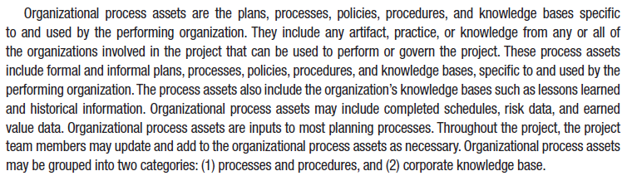
Organizational Process Assets

Slide 10
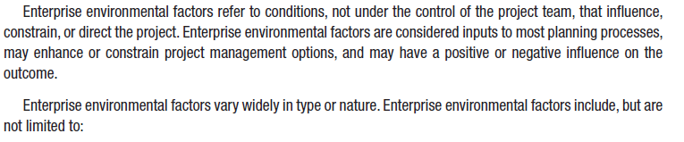
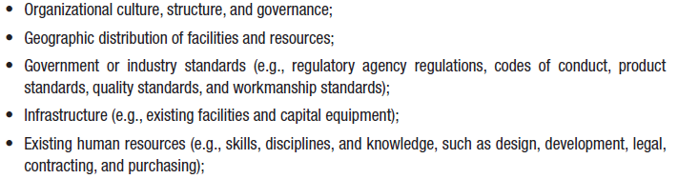
Enterprise Environmental Factors

Slide 11
Stakeholders?
“Stake holders are the persons and Organisation, Sponsors, performing Organisations and Public actively involved in the Project or whose interests will be positively or negatively impact by the execution of the project or who may impacted the project”

Slide 12
Project Stakeholder Management Processes
Identifying stakeholders: Identifying everyone involved in the project or affected by it, and determining the best ways to manage relationships with them.
Planning stakeholder management: Determining strategies to effectively engage stakeholders
Managing stakeholder engagement: Communicating and working with project stakeholders to satisfy their needs and expectations, resolving issues, and fostering engagement in project decisions and activities
Controlling stakeholder engagement: Monitoring stakeholder relationships and adjusting plans and strategies for engaging stakeholders as needed

Slide 13
Identifying Stakeholders
Internal project stakeholders generally include the project sponsor, project team, support staff, and internal customers for the project. Other internal stakeholders include top management, other functional managers, and other project managers
External project stakeholders include the project’s customers (if they are external to the organization), competitors, suppliers, and other external groups that are potentially involved in the project or affected by it, such as government officials and concerned citizens

Slide 14
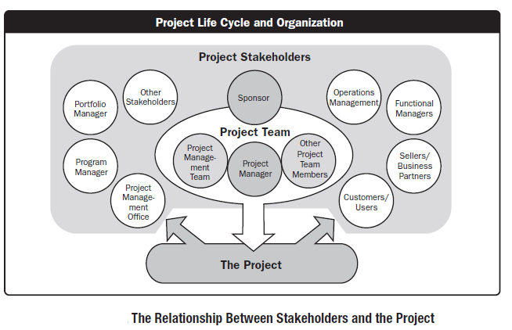
Project Stakeholders

Slide 15
Roles & Responsibilities
Sponsor
PM
Costumer
Project team
SMEs

Slide 16
PM’s Skill
Leadership
Communications
Organizing
Negotiating
Managing conflict
Motivating
Controlling
Team building
Planning
Directing
Problem solving
Coaching
Delegating
Supporting

Slide 17
Additional Stakeholders
  Program director
  Project manager’s family
  Labor unions
  Potential customers
It is also necessary to focus on stakeholders with the most direct ties to a project, for example only key suppliers

Slide 18
Stakeholder Register
A stakeholder register includes basic information on stakeholders:
  Identification information: The stakeholders’ names, positions, locations, roles in the project, and contact information
  Assessment information: The stakeholders’ major requirements and expectations, potential influences, and phases of the project in which stakeholders have the most interest
  Stakeholder classification: Is the stakeholder internal or external to the organization? Is the stakeholder a supporter of the project or resistant to it?

Slide 19
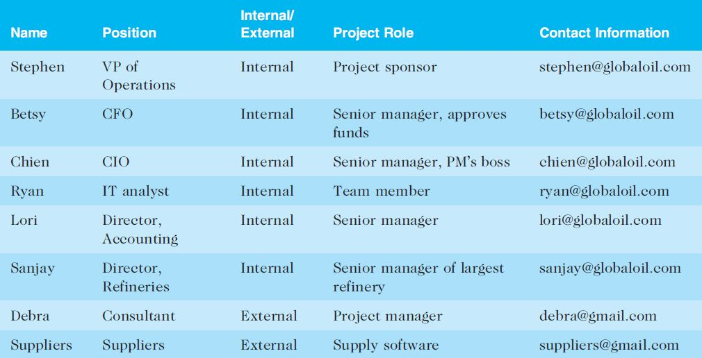
Sample Stakeholder Register

Slide 20
Classifying Stakeholders
After identifying key project stakeholders, you can use different classification models to determine an approach for managing stakeholder relationships
A power/interest grid can be used to group stakeholders based on their level of authority (power) and their level of concern (interest) for project outcomes

Slide 21
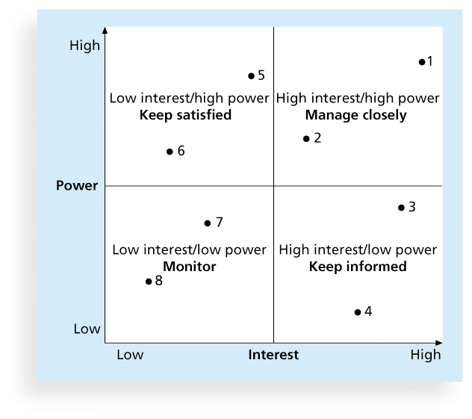
Power/Interest Grid

Slide 22
Stakeholder Engagement Levels
Unaware: Unaware of the project and its potential impacts on them
Resistant: Aware of the project yet resistant to change
Neutral: Aware of the project yet neither supportive nor resistant
Supportive: Aware of the project and supportive of change
Leading: Aware of the project

Slide 23
Issue Logs
Understanding the stakeholders’ expectations can help in managing issues
Issues should be documented in an issue log, a tool used to document, monitor, and track issues that need resolution
Unresolved issues can be a major source of conflict and result in stakeholder expectations not being met
Issue logs can address other knowledge areas as well

Slide 24
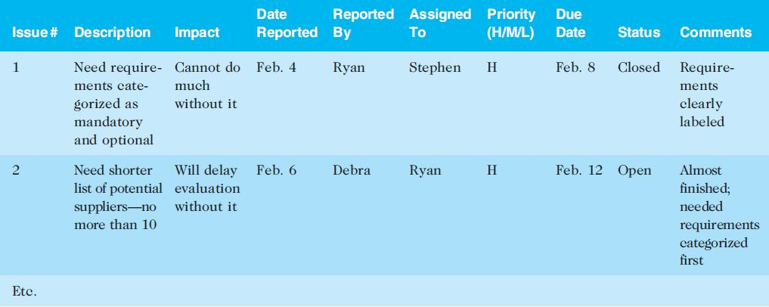
Sample Issue Log

Slide 25
5 Stages of Group Development (Tuckman)
Forming
Storming
Norming
Performing
Adjourning

Slide 26
5 Stages of Group Development
Stage | Theme | Issue
Forming | Awareness | Inclusion
Storming | Conflict | Control
Norming | Cooperation | Cohesion
Performing | Productivity | Team Identity
Adjourning | Separation | Completion

Slide 27
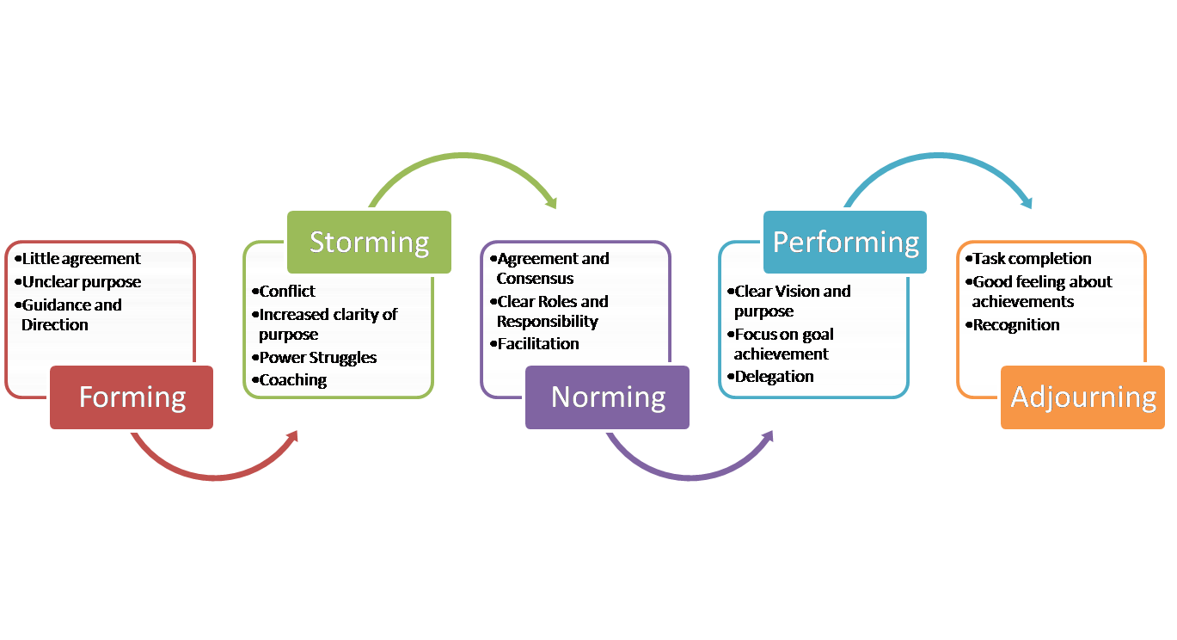

Slide 28
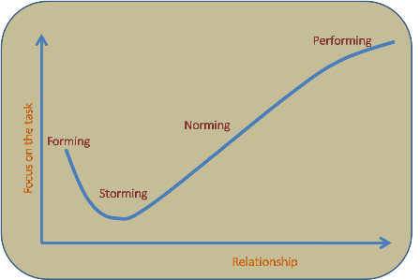

Slide 29
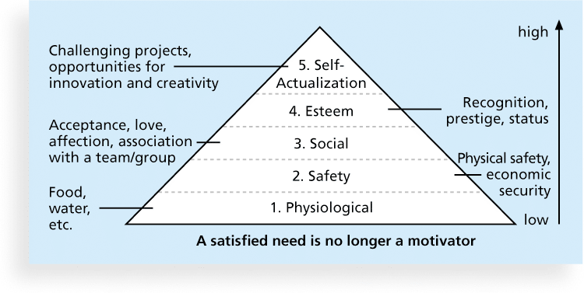
Figure 9-2. Maslow’s Hierarchy of Needs

Slide 30
Herzberg’s Motivational and Hygiene Factors
Frederick Herzberg wrote several famous books and articles about worker motivation. He distinguished between:
  Motivational factors: Achievement, recognition, the work itself, responsibility, advancement, and growth. These factors produce job satisfaction.
  Hygiene factors: Larger salaries, more supervision, and a more attractive work environment. These factors cause dissatisfaction if not present, but do not motivate workers to do more
  Poor hygiene factors may destroy motivation, under most circumstances, will not improve motivation. (you can include more examples in hygiene factor personal life, relationship at work, security and status

Slide 31
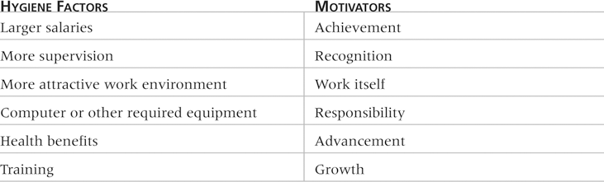
Table 9-1: Examples of Herzberg’s Hygiene Factors and Motivators

Slide 32
McClelland’s Acquired-Needs Theory
Specific needs are acquired or learned over time and are shaped by life experiences. The following are the main categories of acquired needs:
  Achievement (nAch): People with a high need for achievement like challenging projects with attainable goals and lots of feedback.
  Affiliation (nAff): People with high need for affiliation desire harmonious relationships and need to feel accepted by others, so managers should try to create a cooperative work environment for them.
  Power (nPow): People with a need for power desire either personal power or institutional power). Provide institutional power seekers with management opportunities.

Slide 33
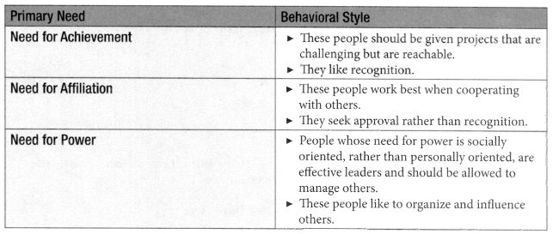
Motivation Theory
David McClelland's Theory of Need
  People are motivated by fulfilling one of the following needs

Slide 34
McGregor’s Theory X and Y
Douglas McGregor popularized the human relations approach to management in the 1960s.
Theory X: Assumes workers dislike and avoid work, so managers must use coercion, threats, and various control schemes to get workers to meet objectives.
Theory Y: Assumes individuals consider work as natural as play or rest and enjoy the satisfaction of esteem and self-actualization needs.

Slide 35


Motivation Theory
McGregor’s Theory of X & Y
Theory X people are incapable. Avoid responsibility & avoid work whenever possible
Theory Y people are willing to work without supervision and want to achieve

Slide 36
Powers of Project Manager
Formal (legitimate)
  Based on position
Reward
  Stems from giving rewards
Penalty (coercive)
  Comes from ability to penalize team members
Expert
  Comes from being the technical or project management expert
Referent
  Comes from another person liking you

Slide 37
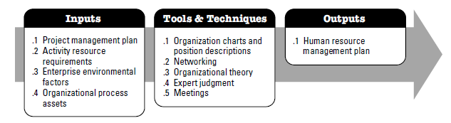
Project Human Resource Management Overview
Plan Human Resource Management
The process of identifying and documenting project roles, responsibilities, required skills, reporting relationships, and creating a staffing management plan. The key benefit of this process is that it establishes project roles and responsibilities, project organization charts, and the staffing management plan including the time table of staff acquisition and release.

Slide 38
Project Human Resource Management Overview
Plan Human Resource Management
Contains following aspects;
Identification of training needs
Team building strategies
Plans for recognition and rewards programs
Compliance considerations
Safety issues
Impact of staffing management plan on the organization

Slide 39
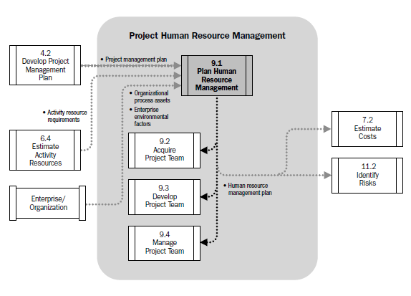
Human Resource Management Data Flow Diagram

Slide 40
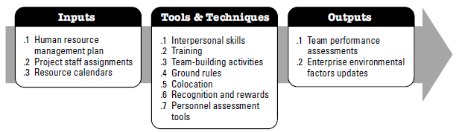
Develop Project Team
Develop Project Team is a process of improving competencies. Team member interaction and overall team environment to enhance project performance.

Slide 41
Work Breakdown Structure (WBS)
Breakdown of project deliverables. How project deliverables are broken down into work packages provide a way of showing high-level areas of responsibility
Organizational Breakdown Structure (OBS)
OBS is arranged according to an organization's existing departments, units or teams with the project activities or work packages listed under each department.
Hierarchical list of resources related by category and resource type that is used to facilitate planning and controlling of project work. Each descending level represents an increasingly detailed description of the resource until small enough to be used in conjunction with WBS to allow the work to be planned, monitored and controlled.
Resource Breakdown Structure (RBS)
It may contain resource categories other than human resources

Slide 42
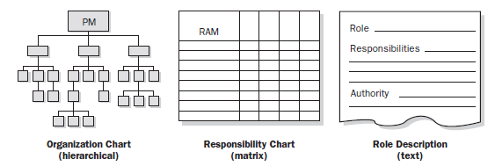
Organization Chart & Position Descriptions
The objective is to ensure that each work package has an unambiguous owner and that all team members have a clear understanding of their roles & responsibilities

Slide 43
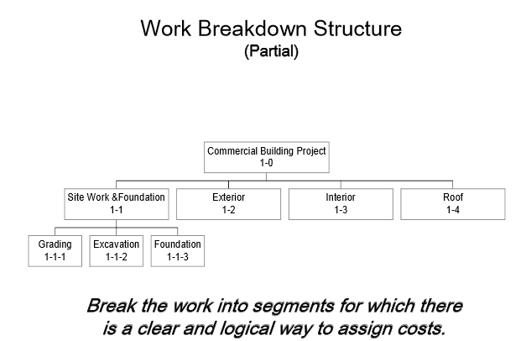
Organization Chart & Position Descriptions

Slide 44
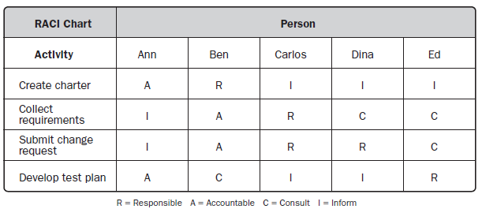
Organization Chart & Position Descriptions
Responsibility Assignment Matrix (RAM)
RAM is a grid that shows the project resources assigned to each work package. It links activities to resources in order to ensure that all work components are assigned to an individual or team

Slide 45
Organization Chart & Position Descriptions
Another variant can be LRC (Linear Responsibility Chart)
It focuses more on naming who is responsible for specified work units at the lower levels of all levels in WBS. As compare to RACI, it shows more of a degree of involvement.

Slide 46
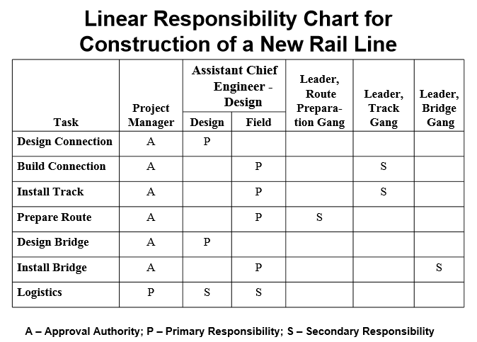
Organization Chart & Position Descriptions

Slide 47
Organization Chart & Position Descriptions
Resource Histogram is a tool that shows number of resources required or assigned over time to a project .
The vertical bars represent the number of people needed in each skill category and by stacking the columns , the total number of resources required for each period can be represented.
This is a handy format to show various stakeholder groups resource views for the project
It can be used to compute the capacity shortages from planned versus available resources.

Slide 48
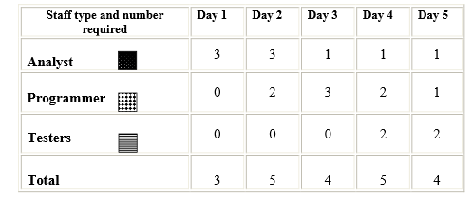
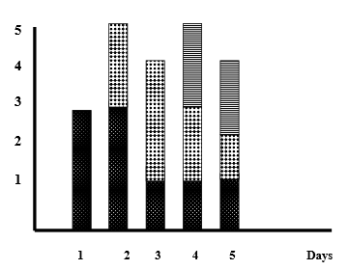
Organization Chart & Position Descriptions

Slide 49
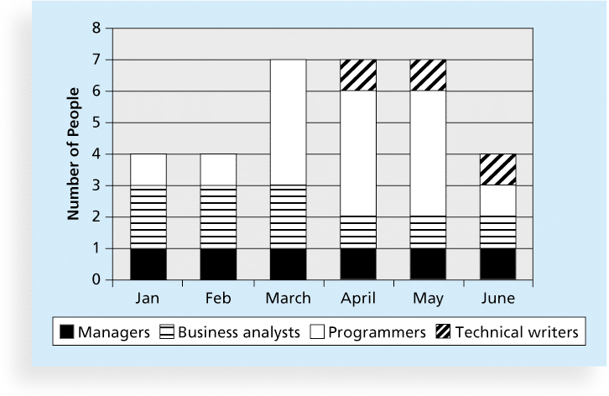
Sample Resource Histogram

Slide 50
A Simple Gantt Chart
Time
J F M A M J J A S
Design
Prototype
Test
Revise
Production

Slide 51
Acquire Project Team – Overview (Cont’d…)
Types of Teams
  Dedicated, Most of team members work full time, easiest team to work, member can dedicate of the energy to work, most common in projectized org, found in matrix, least likely in functional org
  Part-time, spend part of time, also working on other projects or non project work, most often seen in functional and matrix org
  Partnership, where several org undertake project, saving of cost but difficult to manage
  Virtual, multiple organization or offices involved, geographical distance necessitate v teams
Avoiding Pitfalls
  Halo Effect, Halo effect is a concept of unconscious judgment, it is a biased Approach in which an observer's overall impression of some thing. Its works in both positive and negative directions
  Acquire Project Team = Acquire Final Project Team
  Involving people in the work regardless of when they join the project team

Slide 52
Acquire Project Team – Overview (Cont’d…)
Types of Teams
  Dedicated, Most of team members work full time, easiest team to work, member can dedicate of the energy to work, most common in projectized org, found in matrix, least likely in functional org
  Part-time, spend part of time, also working on other projects or non project work, most often seen in functional and matrix org
  Partnership, where several org undertake project, saving of cost but difficult to manage
  Virtual, multiple organization or offices involved, geographical distance necessitate v teams
Avoiding Pitfalls
  Halo Effect, Halo effect is a concept of unconscious judgment, it is a biased Approach in which an observer's overall impression of some thing. Its works in both positive and negative directions
  Acquire Project Team = Acquire Final Project Team
  Involving people in the work regardless of when they join the project team

Slide 53
Acquire Project Team
Acquiring qualified/Talented people for teams is crucial.
Staffing plans and good hiring procedures are important, as are incentives for recruiting and retention.
  Some companies give their employees cash rewards for every hour that a new person who they helped hire works.
  Some organizations allow people to work from home as an incentive.

Slide 54
Acquire HR as People Leave Jobs!
Acquire Project Team
They feel they do not make a difference.
They do not get proper recognition.
They are not learning anything new or growing as a person.
They do not like their coworkers.
They want to earn more money.

Slide 55
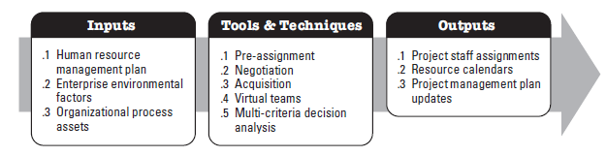
Acquire Project Team

Slide 56
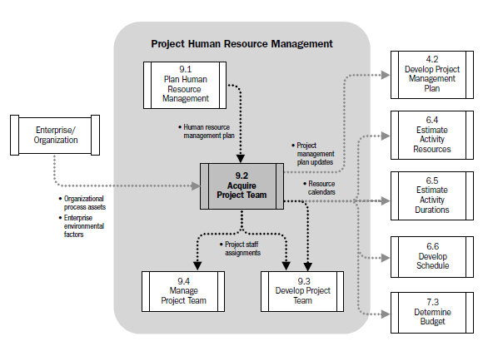
Acquire Project Team

Slide 57
Acquire Project Team – Overview (Cont’d…)
Types of Teams
  Dedicated, Most of team members work full time, easiest team to work, member can dedicate of the energy to work, most common in projectized org, found in matrix, least likely in functional org
  Part-time, spend part of time, also working on other projects or non project work, most often seen in functional and matrix org
  Partnership, where several org undertake project, saving of cost but difficult to manage
  Virtual, multiple organization or offices involved, geographical distance necessitate v teams
Avoiding Pitfalls
  Halo Effect, Halo effect is a concept of unconscious judgment, it is a biased Approach in which an observer's overall impression of some thing. Its works in both positive and negative directions
  Acquire Project Team = Acquire Final Project Team
  Involving people in the work regardless of when they join the project team

Slide 58
Acquire Project Team
Acquiring qualified/Talented people for teams is crucial.
Staffing plans and good hiring procedures are important, as are incentives for recruiting and retention.
  Some companies give their employees cash rewards for every hour that a new person who they helped hire works.
  Some organizations allow people to work from home as an incentive.

Slide 59
Acquire HR as People Leave Jobs!
Acquire Project Team
They feel they do not make a difference.
They do not get proper recognition.
They are not learning anything new or growing as a person.
They do not like their coworkers.
They want to earn more money.

Slide 60
Acquire Project Team - ITTOs
Inputs
  Human Resource Management Plan
  Enterprise Environmental Factors
  Organizational Process Assets
Tools & Techniques
  Pre-Assignment
  Negotiation
  Acquisition
  Virtual Teams
  Multi-criteria Decision Analysis
Outputs
  Project Staff Assignments
  Resource Calendars
  Project Management Plan Updates

Slide 61
Important Factors
Project Management Team may or may not have direct control over team member selection
Affect of the Non- availability of necessary human resource on;
  Project Schedule
  Project Budget
  Project Risks
  Project Quality
  Training Plans
  Project Management Plans as a whole

Slide 62
Acquire Project Team Inputs
Human Resource Management Plan
Enterprise Environmental Factors
Organizational Process Assets

Slide 63
Human Resource Management Plans Inputs
How Project Human Resource should be;
Roles & Responsibilities defining the positions, skills and competencies that the project demands.
Project organization charts indicating the number of people needed for the project.
Staffing management plans elucidating the time periods each project member will be needed and other information important to engage the project team.
Identified
Staffed
Managed
Released

Slide 64
Enterprise Environmental Factors Inputs
EEF refer to conditions, not under the control of the project team, that influence, constrain or direct the project . These include but not limited to;
Existing information on Human Resources including availability, competency levels, prior experience, interest in working on the project and their cost rate.
Personal administration policies such as those which can effect outsourcing.
Organization structures as described in
Colocation or multiple locations.

Slide 65
Organizational Process Assets Inputs
Organizational Process Assets are the plans, procedures, processes and knowledge base specific to and used by the performing organization. OPA may be grouped into two categories;
Processes and Procedures
Initiating & Planning
Executing, Monitoring & Controlling
Closing
Configuration management knowledge base
Financial databases
Historical information and lessons learned.
Issue and defect management database.
Process measurement database.
Project files.
Corporate Knowledge Base

Slide 66
Acquire Project Team Tools & Techniques
APT T&T
Pre-Assignment
Negotiation
Acquisition
Virtual Teams
Multi-Criteria Decision Analysis

Slide 67
Pre-Assignment Tools & Techniques
When project team members are selected in advance, they are considered pre-assigned.
The situation can occur if;
The project is the result of specific people being identified as part of a competitive proposal.
If the project is dependent upon the expertise of particular persons.
If some staff assignments are defined within the project charter.

Slide 68
Negotiation Tools & Techniques
Staff assignments are negotiated on many projects. The project management team may need to negotiate with;
To ensure that the project receives appropriately competent staff in the required time frame
Project team members will be able, willing and authorized to work on the project until their responsibilities are completed.
Functional Managers
Other project management teams within the performing organization, to appropriately assign scarce or specialized human resources
Other Project Management Teams
For appropriate, scarce, specialized, qualified, certified or other such specified human resources.
Special considerations should be given to external negotiating policies, practices, processes, guidelines, legal and other such criteria
External Organizations

Slide 69
Negotiation Tools & Techniques
The project management’s team ability to influence others plays an important role in negotiating staff assignments, as do the politics of the organization involved.
As an example, a functional manager will weigh the benefits and visibility of competing projects when determining where to assign exceptional performers requested by various project teams.

Slide 70
Negotiation Tools & Techniques
Negotiation process involves in dealing with another person or party to settle a matter.
In successful negotiation, everyone wins
Objective should be agreement not victory
Settlement of issue for benefit of all parties
Two essential things for negotiation. Influence & Confidence
Negotiation Process (3Fs)
Fair, Fast and Firm

Slide 71
Negotiation Tools & Techniques
During Negotiation;
Be firm yet polite when making a stand.
Emphasize advantages & disadvantages of your approach.
Put ego aside and concentrate on the matter at hand.
Aim for solutions that are interest based and not based only on what any individual desires.
Value time, schedules and deadlines. Try not to waste time, but be sensitive to the other party’s needs to discuss.

Slide 72
Virtual Teams Tools & Techniques
A new possibility of acquiring project team members
Disadvantages;
Possibility of misunderstandings.
Feeling of isolation.
Difficulties in sharing knowledge and experience between team members.
Appropriate technology.
Importance of communication planning.
Additional time for conflict resolution, decision making, cultural differences, sharing of success credit.
Advantages;
Teams from widespread geographical areas.
Addition of special expertise.
Different shifts, days, hours.
Mobility limitations and disabilities.
Overcome project constraints of travel expense.

Slide 73
Project Staff Assignments Outputs
The project is staffed when appropriate people have been assigned to the team
The documentation of these assignments can include;
Project team directory.
Memos to team members.
Names inserted into other parts of the project management plan such as project organization charts and schedules.

Slide 74
Develop Project Team
Develop Project Team is a process of improving competencies. Team member interaction and overall team environment to enhance project performance.

Slide 75
Objectives of Developing a Project Team
Improving knowledge and skills of team members
Improving feelings of trust and agreement among team members to raise morale, lower conflict and increase team work.
Creating a dynamic, cohesive and collaborative culture to;
1) Improve individual and team productivity, team spirit, and cooperation and
2) Allow cross training and mentoring between
team members to share knowledge and
expertise.

Slide 76
BENEFITS
Improved Team Work
People skills and competencies
Motivated Employees
Reduced Staff Turnover Rates
Improved overall project performance

Slide 77
Develop Project Team Tools & Techniques
DPT T&T
Interpersonal Skills
Training
Team Building Activities
Ground Rules
Colocation
Recognition & Rewards
Personnel Assessment Tools

Slide 78
Interpersonal Skills Tools & Techniques
Communication Skills
Emotional Intelligence
Negotiation
Conflict Resolution
Influence
Team Building
Group Facilitation
SOFT SKILLS

Slide 79
Training Tools & Techniques
What will you be doing?
  1. Conduct a needs assessment and analysis.
  2. Design a training program.
  3. Develop a training program.
  4. Recommend implementation and delivery of training.
  5. Evaluate the training.

Slide 80
Team Building Activities Tools & Techniques
Team building activities can vary from a 5 minute agenda item in a status review meeting to an offsite professionally facilitated experience designed to improve interpersonal relationships.
The objective of team-building activities is to help individual team members work together effectively.
These strategies are particularly valuable when team members operate from remote locations without the benefit of face-to-face contact.
Informal communication and activities can help in building trust and establishing good working relationships.

Slide 81
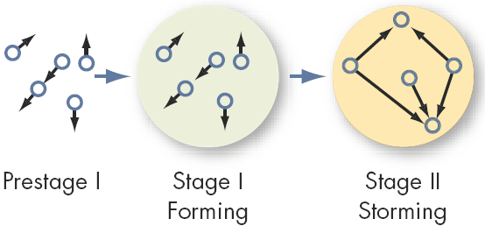
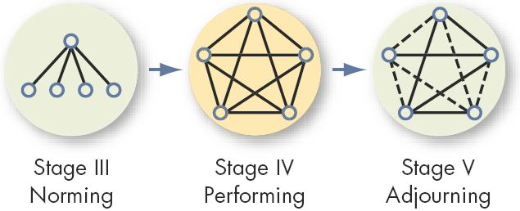
Team Building Activities Tools & Techniques
THE FIVE STAGE TEAM DEVELOPMENT MODEL

Slide 82
Ground Rules Tools & Techniques
Clear expectations regarding acceptable behavior by project team members.
Early commitment to clear guidelines decreases misunderstandings and increases productivity.
Discussing ground rules in areas such as;
Code of conduct
Communication
Working Together
Meeting Etiquette
Shared Responsibility

Slide 83
Establishing Ground Rules Tools & Techniques
Establishing operational ground rules for how the team will work together.
Consists of not only organizational and procedural issues but also how the team will interact with each other.

Slide 84
Colocation Tools & Techniques
Placing many or all of the most active project team members in the same physical location to enhance their ability to perform as a team
Temporary
Permanent
War Room
While Colocation is considered as a good strategy, the use of virtual teams can bring benefits such as proximity of team members to suppliers, customers, or other key stakeholders.

Slide 85
Recognition & Rewards Tools & Techniques
The original plans concerning ways in which to reward people are developed during the ‘Plan Human Resource Management Process’.
Pertinent Aspects
Satisfaction of need which is valued by that individual.
Take care of Cultural Differences.
Tangible & Intangible Rewards.
Team Recognition throughout the Life Cycle
Function of Project Performance Appraisals.

Slide 86
Managing Project Reward System Tools & Techniques
Recognizing individual members regardless of their accomplishments can distract from team unity.
Group Rewards
  Who gets what reward?
  How to make the reward have lasting significance?
  How to recognize individual performance?
    Letters of commendation
    Public recognition for outstanding work
    Desirable job assignments
    Increased personal flexibility

Slide 87
Personnel Assessment Tools Tools & Techniques
These tools give the Project Manager and the project team insight into areas of strength and weakness.
These tools help project managers assess the team preferences, aspirations, how they process and organize information, how they tend to make decisions, and how they prefer to interact with people.
Attitudinal Surveys
Specific Assessments
Structured Interviews
Ability Tests
Focus Groups

Slide 88
Who Performs the Appraisal?
Immediate Supervisor
Higher Management
Self-Appraisals
Peers (Co-Workers)
Evaluation Teams
Customers
“360° Appraisals”

Slide 89
APPRAISAL TYPES
Management by Objectives. MBO evaluates how well an employee has accomplished objectives determined to be critical in job performance. This method aligns objectives with quantitative measures such as sales, profits, zero-defect , units produced.
360 Degree Performance Multi-source Feedback which involves evaluation by all the members of the organization that are in connection with the person in question including himself, his peers, sub-ordinates, supervisors and even the external customers. It usually starts off with self-evaluation but afterwards all relevant supervisors, peers and sub-ordinates evaluate the person in question. This is a modern tool in performance evaluation.
Peer Appraisal Performance appraisal done by one’s fellow employees
Team Performance Appraisal based on TQM concepts, that recognizes team accomplishment rather than individual performance

Slide 90
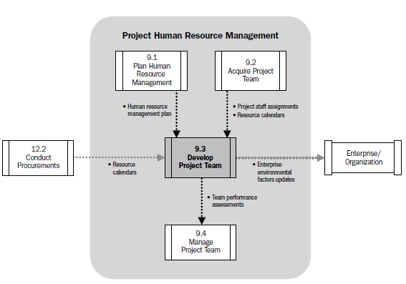
Develop Project Team
Data Flow Diagram

Slide 91
Critical Factors
Environment that facilitates Team Work
Motivation with Challenges and Opportunities
Timely Feedback and Support
Recognizing and Rewarding Good Performance

Slide 92
Factors for High Team Performance
Open & Effective Communication
Creating Team Building Opportunities
Reducing Trust Deficit
Constructive Conflict Management
Encourage Collaborative Problem Solving and Decision Making
TEAM PERFORMANCE

Slide 93
Objectives Of Developing A Project Team
Improving knowledge and skills of team members
  In order to complete project deliverables, while reducing costs, reducing schedules, and improving quality
Enhancing trust and agreement between team members, in order to
  Raise morale
  Reduce conflict
  Increase teamwork
Creating a dynamic, cohesive, and collaborative team culture, in order to
  Improve individual and team productivity, team spirit and cooperation, and
  Allow cross training, to share knowledge and expertise

Slide 94
Develop Project Team Inputs
Human Resource Management Plan
Resource Calendars
Project Staff Assignments

Slide 95
Human Resource Management Plans Inputs
How Project Human Resource should be;
Identification of training strategies and plans to develop project team.
Identified
Staffed
Managed
Released
REWARDS
FEEDBACK
ADDITIONAL TRAINING
DISCIPLINARY ACTIONS

Slide 96
Project Staff Assignments Inputs
WHO IS WHO IN THE TEAM
The project is staffed when appropriate people have been assigned to the team
The documentation of these assignments can include;
Project team directory.
Memos to team members.
Names inserted into other parts of the project management plan such as project organization charts and schedules.

Slide 97
Resource Calendars Inputs
It documents the time periods that each project team member is available to work on the project.
Creating a reliable schedule depends on having good understanding of each person’s availability and schedule constraints including;
- Time zones
- Working hours
- Vacation Time
- Local Holidays
- Commitments to other projects

Slide 98
Develop Project Team Tools & Techniques
DPT T&T
Interpersonal Skills
Training
Team Building Activities
Ground Rules
Colocation
Recognition & Rewards
Personnel Assessment Tools

Slide 99
Interpersonal Skills Tools & Techniques
Communication Skills
Emotional Intelligence
Negotiation
Conflict Resolution
Influence
Team Building
Group Facilitation
SOFT SKILLS

Slide 100
Training Tools & Techniques
What will you be doing?
  1. Conduct a needs assessment and analysis.
  2. Design a training program.
  3. Develop a training program.
  4. Recommend implementation and delivery of training.
  5. Evaluate the training.

Slide 101
Team Building Activities Tools & Techniques
Team building activities can vary from a 5 minute agenda item in a status review meeting to an offsite professionally facilitated experience designed to improve interpersonal relationships.
The objective of team-building activities is to help individual team members work together effectively.
These strategies are particularly valuable when team members operate from remote locations without the benefit of face-to-face contact.
Informal communication and activities can help in building trust and establishing good working relationships.

Slide 102
Team Building Activities Tools & Techniques
THE FIVE STAGE TEAM DEVELOPMENT MODEL

Slide 103
Ground Rules Tools & Techniques
Clear expectations regarding acceptable behavior by project team members.
Early commitment to clear guidelines decreases misunderstandings and increases productivity.
Discussing ground rules in areas such as;
Code of conduct
Communication
Working Together
Meeting Etiquette
Shared Responsibility

Slide 104
Establishing Ground Rules Tools & Techniques
Establishing operational ground rules for how the team will work together.
Consists of not only organizational and procedural issues but also how the team will interact with each other.

Slide 105
Colocation Tools & Techniques
Placing many or all of the most active project team members in the same physical location to enhance their ability to perform as a team
Temporary
Permanent
War Room
While Colocation is considered as a good strategy, the use of virtual teams can bring benefits such as proximity of team members to suppliers, customers, or other key stakeholders.

Slide 106
Recognition & Rewards Tools & Techniques
The original plans concerning ways in which to reward people are developed during the ‘Plan Human Resource Management Process’.
Pertinent Aspects
Satisfaction of need which is valued by that individual.
Take care of Cultural Differences.
Tangible & Intangible Rewards.
Team Recognition throughout the Life Cycle
Function of Project Performance Appraisals.

Slide 107
Managing Project Reward System Tools & Techniques
Recognizing individual members regardless of their accomplishments can distract from team unity.
Group Rewards
  Who gets what reward?
  How to make the reward have lasting significance?
  How to recognize individual performance?
    Letters of commendation
    Public recognition for outstanding work
    Desirable job assignments
    Increased personal flexibility

Slide 108
Personnel Assessment Tools Tools & Techniques
These tools give the Project Manager and the project team insight into areas of strength and weakness.
These tools help project managers assess the team preferences, aspirations, how they process and organize information, how they tend to make decisions, and how they prefer to interact with people.
Attitudinal Surveys
Specific Assessments
Structured Interviews
Ability Tests
Focus Groups

Slide 109
Who Performs the Appraisal?
Immediate Supervisor
Higher Management
Self-Appraisals
Peers (Co-Workers)
Evaluation Teams
Customers
“360° Appraisals”

Slide 110
APPRAISAL TYPES
Management by Objectives. MBO evaluates how well an employee has accomplished objectives determined to be critical in job performance. This method aligns objectives with quantitative measures such as sales, profits, zero-defect , units produced.
360 Degree Performance Multi-source Feedback which involves evaluation by all the members of the organization that are in connection with the person in question including himself, his peers, sub-ordinates, supervisors and even the external customers. It usually starts off with self-evaluation but afterwards all relevant supervisors, peers and sub-ordinates evaluate the person in question. This is a modern tool in performance evaluation.
Peer Appraisal Performance appraisal done by one’s fellow employees
Team Performance Appraisal based on TQM concepts, that recognizes team accomplishment rather than individual performance

Slide 111
The 360º Appraisal Interview
Supervisor
Other Superiors
Other Superiors
Individual Staff
Self-Assessment
Peers
Customers
Teams
Teams
Sub-Ordinates

Slide 112
Employee Performance Evaluations
Everyone is entitled to be stupid, but some abuse the privilege.
Since my last report, he has reached rock bottom and has started to dig.
His men would follow him anywhere, but only out of curiosity.
I would not allow this employee to breed.
Works well when under constant supervision and cornered in a trap.
When he opens his mouth, it seems that this is only to change whichever foot was previously in there.
He is in the habits of pushing doors marked pull.
This employee should go far --- and the sooner he starts, the better.
If brains were taxed, he'd get a rebate.

Slide 113
Develop Project Team Outputs
DPT Outputs
Team Performance Assessments
Enterprise Environmental Factors Updates

Slide 114
Team Performance Assessments Outputs
Formal and Informal assessments of Project Team’s Effectiveness
Should be determined by all parties
Technical Success
Agreed upon Project Objectives
Meeting Quality Levels
Performance on Project Schedule
Performance on Budget

Slide 115
Team Performance Assessments Outputs
Improvements in skills that allow individuals to perform assignments more effectively.
Improvements in competencies that help the team perform better as a team.
Reduced turnover Rate
Increased team cohesiveness where team members share information and experiences openly and help each other to improve the overall project performance.
Specific Training
Coaching
Mentoring
Assistance
Required Resources

Slide 116
Enterprise Environmental Factors Updates Outputs
The enterprise environmental factors that may be updated as a result of the ‘Develop Project Team Process’ include but are not limited to;
  Personal Administration.
  Employee Training Records.
  Skill Assessments.

Slide 117
What is conflict?
A battle, contest or opposing forces existing between primitive desires and moral, religious or ethical ideas ( Webster’s Dictionary)
A state of incompatibility of ideas between two or more parties or individuals
Conflict management is the practice of identifying and handling conflict in a sensible, fair and efficient manner

Slide 118

CONFLICT HAPPENS
Conflict is…
a normal, inescapable part of life
a periodic occurrence in any relationship
an opportunity to understand opposing preferences and values
ENERGY

Slide 119
Conflict Management
The term conflict management is sometimes used interchangeably with conflict resolution. The difference, however, is that the concept of conflict management is based on a premise that not all disputes end in resolution.
Additionally, conflict management is the practice of identifying and handling conflict in a sensible, fair, and efficient manner. Conflict management is any collection of actions, responses, processes, and/or systems that help manage, improve, or prevent the deterioration of relationship dynamics.
When the parties can not resolve the dispute, they use strategies to manage the dispute and acknowledge their differences. Conflict management makes the parties to a dispute aware of their options. It allows them to examine their own assessments, to communicate their feelings and assessments, and to choose options that avoid defensive reactions

Slide 120
Conflict Management
Sources of Conflict
Value Conflict
Data Conflict
Interest Conflict
Structural Conflict

Slide 121
Types of conflict
Inter-personal and intra-personal
Inter-group and intra-group
Competitive and Disruptive

Slide 122
Conditions
Scarce Resources
Conflicting attitude
Ambiguous jurisdiction
Communication barriers
Need for consensus
Unresolved prior conflicts
Knowledge of self and others

Slide 123
How to create conflict?
Not being a role model
Take credit, no recognition
Be judgmental
Send written messages
Subordinate should come to see me
Make yourself inaccessible to your team
Individual Vs team approach
Telling them? Consulting them? Or deciding with them?
Come tomorrow
Introduce change without consultation or discussion

Slide 124
Effects of conflict in organizations
Stress
Absenteeism
Staff turnover
De-motivation
Non-productivity

Slide 125

Tools for
Conflict Management

Slide 126

BLAME
What doesn’t
work

Slide 127

You get the picture…
What doesn’t
work

Slide 128

The “third party”
What does
work

Slide 129

Contribution Mapping
What does
work

Slide 130
5 ways to manage conflict
Avoidance
Accommodation (B)
Compromise (C)
Collaboration (D)
Force
Notes:
First, write A,B, C, D in a column on the board; tell students you want to know where their scores fell and would like them to raise their hands to show where their highest score occurred as you read out each letter. Total the number of hands raised on each and provide a number so all can see where styles are clustered.
There are five ways of managing conflict, and each has its place.
First, (and not measured on this questionnaire) is to manage conflict by avoiding it. And there are many instances when a manager might chose to avoid conflict. For example, if the conflict is a flare-up between volatile persons who will soon forget the conflict, there is no point for the manager to get involved. Similarly, if the conflict is unimportant it may also be prudent to avoid it. The point is, sometimes avoidance is a good policy. (Sometimes in my family life, I will avoid a conflict if it appears that my spouse is tired or grouchy, for example.)
Often conflict cannot be avoided at which point we engage. Most people tend to have a preferred style of conflict management, and those are the preferences you showed by scoring highest on A, or B or C or D. So we see that in this class, we have many people who are (fill in the blank).

Slide 131
Conflict Management
Smooth/ Accommodate
Compromise/ Reconcile
Force/ Direct
Collaborate/ Problem Solve
Withdraw / Avoid
Retreating from an actual or potential conflict situation; postponing the issue to be better prepared or to be resolved by others.
Emphasizing areas of agreement rather than areas of difference; conceding one’s position to the needs of others to maintain harmony and relationships.
Searching for solutions that bring some degree of satisfaction to all parties in order to temporarily or partially resolve the conflict.
Pushing one’s viewpoint at the expense of others; offering only win-lose situations, usually enforced through a power position to resolve an emergency.
Incorporating multiple viewpoints and insights from differing perspectives; requires a cooperative attitude and open dialogue that typically leads to consensus and commitment.

Slide 132
Conflict Continuum
I win, you lose (competition—A)
    I lose or give in (accommodate—B)
      We both get something (compromise—C)
      We both “win”(collaborate—D)
      A B C D
Notes:
First, let’s think about conflict as it unfolds for you. Think about one example (personal or professional) of when you used a particular style and tell us how that position worked for you.
Here are pluses and minuses for each style:

Slide 133
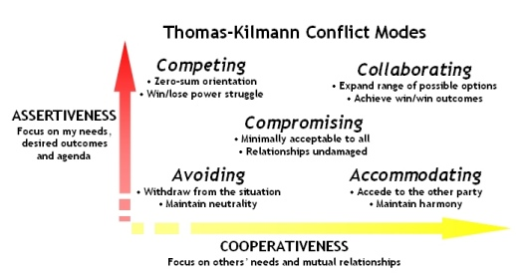
Conflict Management
It is used when outcome is more important than relationship, e.g., in emergencies.
This also involves assertiveness but not cooperation.
Can mean running away but evasion or delay can be appropriate and constructive. This approach can be useful in highly emotional situations where time is needed to gain perspective.
Both sides agreeing to make small or superficial concessions. Both parties make concession and bargaining to and reach a settlement to which both agree.
Cooperation wherein one side agrees to other's wants. Usually occurs when the outcome of the situation is very important to one person but less so to the other.
Meeting underlying needs of both parties.
It allows assertiveness and cooperation in the search for a solution that meets the needs of all.

Slide 134
How to create conflict?
Not being a role model
Take credit, no recognition
Be judgmental
Send written messages
Subordinate should come to see me
Make yourself inaccessible to your team
Individual Vs team approach
Telling them? Consulting them? Or deciding with them?
Come tomorrow
Introduce change without consultation or discussion

Slide 135
Conflicts Reasons
Schedule
Priorities
Recourses
Technical opinion
Admn Procedures
Cost
Personality

Slide 136
Project Communications Management
Ms PM

Slide 137
Communications Planning
Involves identifying the information and communications needs of the stakeholders
This includes determining what needs to be communicated, to whom, when, with what method and how frequently
Very proactive approach

Slide 138
STAKEHOLDERS
Identify All of them
Determine all of their requirements
Determine their expectations
Determine their interests
Determine their level of influence
Plan how you will communicate with them
Manage their expectation and influence

Slide 139
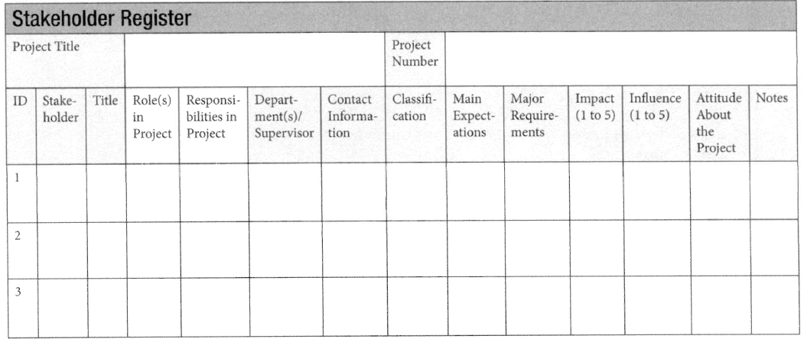
Stakeholder Register

Slide 140
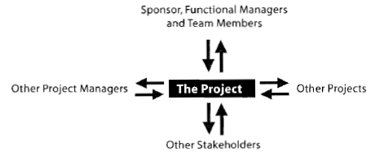
Whom do we communicate with?
The information needs to be distributed to the following:
  Internal to the project
  External to the project
  Sponsor
  Management
  Project Manager
  Team
  Team member’s managers
  Other project managers
  Other stakeholders

Slide 141
Communications Model
It looks like a circle with three parts:
  The sender
  The message
  The receiver
Each message is encoded by the sender and decoded by the receiver based on the receiver’s education, experience, language and culture

Slide 142
Effective Communication
The sender should encode a message carefully, determine the communications method used to send it, and confirm that the message is understood
  Nonverbal : About 55% of all communication
  Paralingual: Pitch and tone of voice
  Feedback: “do u understand what I said?”

Slide 143
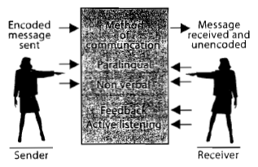
Effective Listening
The receiver should decode the message carefully and confirm the message is understood
This includes
  Feedback
  Active Listening
  Paralingual

Slide 144
Communications Methods
Interactive Communication
  Conversation, meetings & conference call
Push Communication (One way stream; no feedback is expected)
  Email updates, Company memos etc
Pull Communication (info is placed at central location; recipients retrieve )

Slide 145
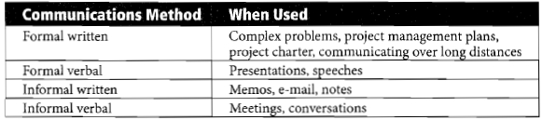
Communications Methods
Decision regarding whether the communication needs to be formal or informal, written or verbal, needs to be made for each instance of communication

Slide 146
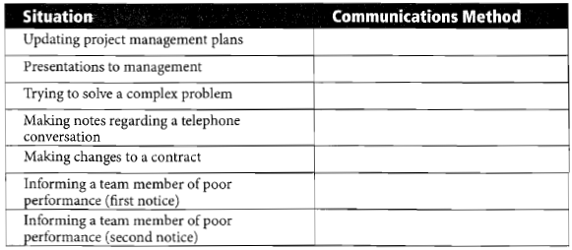
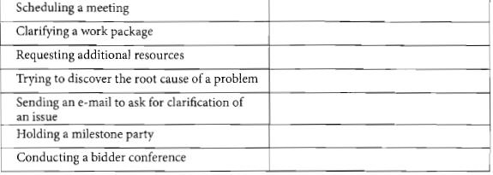

Slide 147
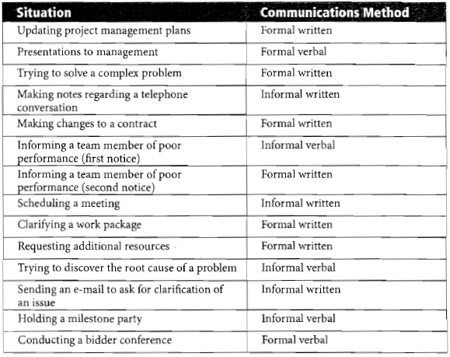

Slide 148

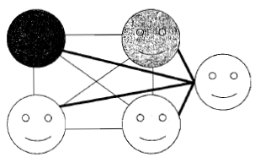
Communication Channels
Adding one more person to the team, communications grow exponentially
Channel calculation formula:
  [N (N-1)/2] where N = number of people

Slide 149
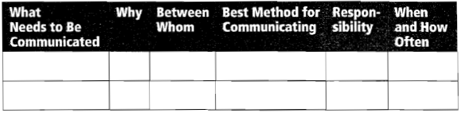
Communications Management Plan
Its the output of communications planning
It documents how you will manage and control communications
Many people do not realize the extent of the information that must be distributed

Slide 150
Information Distribution
It involves implementing the communications management plan
Since not everything can be planned, information distribution also involves creating reports providing information that was not planned

Slide 151
Lessons Learned
This document includes what was done right, wrong, and what would be done differently if the project could be redone
To be as valuable as possible, lessons learned should cover these areas:
  Technical aspects of project
  Project management
  Management

Slide 152
Performance Reporting
It collects performance data and sends it to stakeholders
Reports should provide the kind of information and the level of detail required by stakeholders and may include:
  Status Report
  Progress Report
  Trend Report
  Forecasting Report
  Variance Report
  Earned Value
  Lessons Learned

Slide 153
Communication Blockers
The following might get in the way of communications:
  Noise
  Distance
  Improper encoding of messages
  Saying “That is a bad idea”
  Hostility
  Language
  Culture

Slide 154
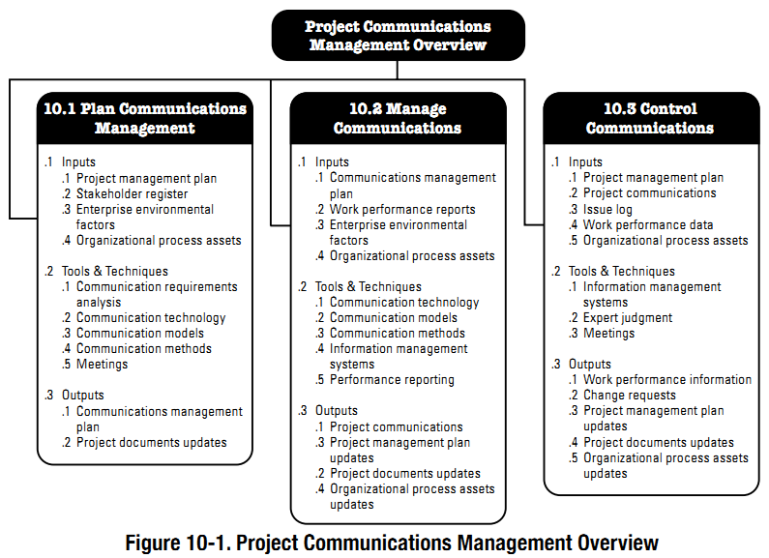

Slide 155
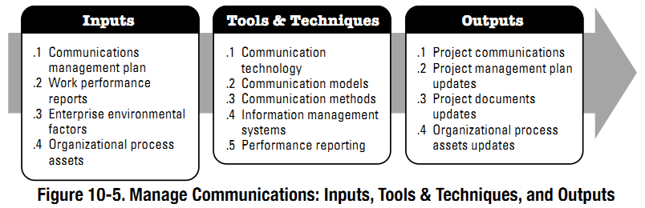
Manage Communications Process
The process of creating, collecting, distributing, storing, retrieving and the ultimate disposition of project information in accordance with the communications management plan
Key Benefit: It enables an efficient and effective communications flow between project stakeholders

Slide 156
Manage Communications Process (Cont’d…)
This process ensure that the information is flowing back-and-forth as planned
It is about implementation of communications management plan i.e. fulfillment of information needs of stakeholders using the technology, models, and methods established in the plan
Goes beyond (only) distribution of relevant information – and ensure that the information being communicated has been properly generated, received and understood
The project manager (should) provide(s) opportunities for stakeholders to request for further information and clarification, as needed

Slide 157
Manage Communications Process – ITTOs
Inputs
  Communications Management Plan
  Work Performance Reports
  EEFs & OPAs
Tools & Techniques
  Communication Technology
  Communication Models
  Communication Methods
  Information Management System
  Performance Reporting
Outputs
  Project Communications
  Project Management Plan Updates
  Project Documents Updates
  OPA Updates

Slide 158
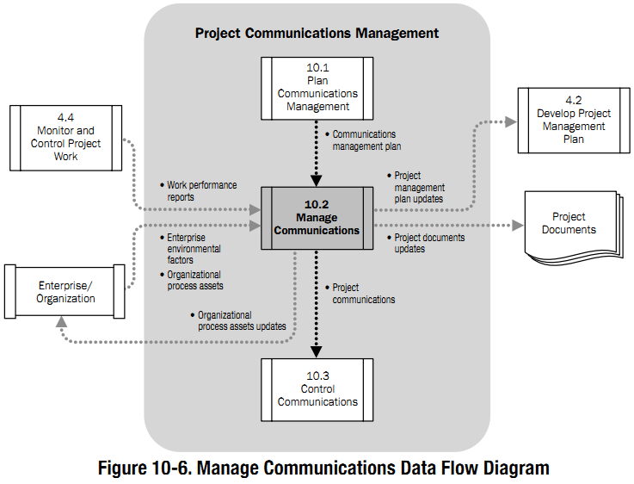

Slide 159
Manage Communications Process – Inputs
Communications Management Plan
  Describes how project communications will be planned, structured, monitored and controlled
  Communications management is conducted in the light of this plan
Work Performance Reports
  Are a collection of project performance and status information that may be used to facilitate discussion and to create communications
  Should be comprehensive, accurate and available in a timely manner
EEFs & OPAs

Slide 160
Manage Communications Process – Tools & Techniques
Communication Technology
  To ensure that choice of communication technology is appropriate for the information being communicated
Communication Models
  To ensure that choice of communication model is appropriate for the project and any barriers (noise) are identified and managed
Communication Methods
  To ensure that the information created and distributed (during the project) has been received and understood to enable response and feedback
Information Management System
  Includes the tools used to manage and distribute the project information. E.g
    Hard-Copy document management (e.g. letters, reports, etc)
    Electronic Communication (e.g. emails, telephone, fax, websites etc.)
    Electronic Project Management Tools (e.g. Project Management software tools like MS-Project, Primavera, MS-Sharepoint – for scheduling and collaboration)

Slide 161
Manage Communications Process – Tools & Techniques (Cont’d…)
Performance Reporting
  Collecting and distributing performance information, including startup reports, progress measurements, and forecasts
  Includes periodic collection and analysis of ‘baseline-Vs.-actual’ data
  Involves understanding of project performance, and forecasting project results
  Provision of relevant information for project stakeholders through project reports
  Project Reports
    Simple Reports
      E.g. Percentage complete of Scope, Schedule, Cost, Quality etc.
    Detailed Reports:
      E.g. Status Reports, Progress Reports, Trend Reports, Forecasting Reports, Variance Reports, Earned Value Reports, Lessons

Slide 162
Manage Communications Process – Outputs
Project Communications
  Performance reports
  Status of Deliverables
  Schedule Progress
  Costs Incurred, etc.
Project Management Plan Updates
  Includes project baselines, stakeholder management plan etc.
  Performance is measured against baselines, and deviations are measured for management control.
  PM Plan may need to be updated based on the current project performance
Project Documents Updates
OPA Updates

Slide 163
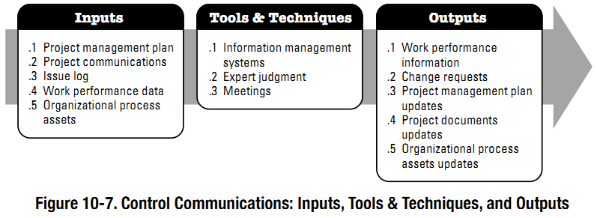
Control Communications Process
The process of monitoring and controlling communications throughout the entire project life cycle to ensure the information needs of the project stakeholders are met
Key Benefit: Ensure an optimal information flow among all communication participants, at any moment in time

Slide 164
Control Communications Process – ITTO’s
Inputs
  Project Management Plan
  Project Communications
  Issue Log
  Work Performance Data
  Organizational Process Assets
Tools & Techniques
  Information Management Systems
  Expert Judgment
  Meetings
Outputs
  Work Performance Information
  Change Requests
  Project Management Plan Updates
  Project Documents Updates
  OPA Updates

Slide 165
Control Communications Process
The process of monitoring and controlling communications throughout the entire project life cycle to ensure the information needs of the project stakeholders are met
Key Benefit: Ensure an optimal information flow among all communication participants, at any moment in time

Slide 166
Control Communications Process – ITTO’s
Inputs
  Project Management Plan
  Project Communications
  Issue Log
  Work Performance Data
  Organizational Process Assets
Tools & Techniques
  Information Management Systems
  Expert Judgment
  Meetings
Outputs
  Work Performance Information
  Change Requests
  Project Management Plan Updates
  Project Documents Updates
  OPA Updates

Slide 167
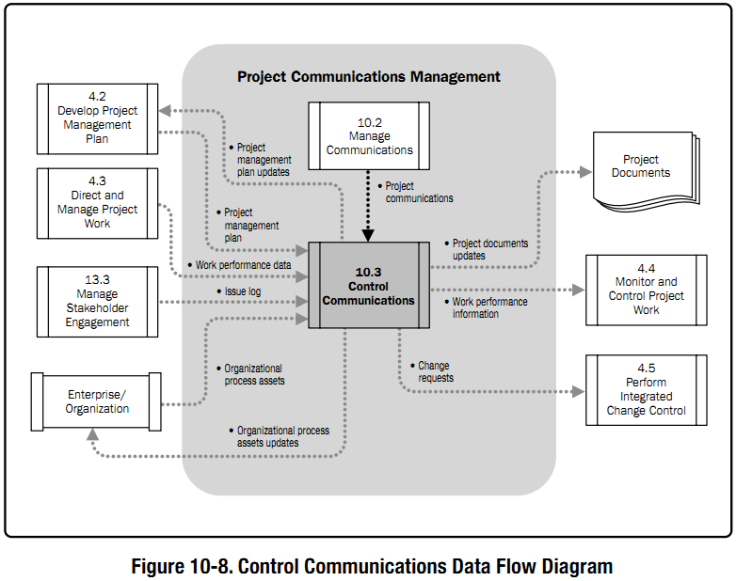

Slide 168
Detailed Discussion
Control Communications Process – Inputs
Project Management Plan
  Describes how project will be executed, monitored, controlled and closed.
  Provides information for Control Communications, e.g.:
    Stakeholder Communication Requirements
    Reason for distribution of information
    Time and Frequency of information distribution
    People responsible for communication of information
    The receiver of the information
Project Communications
  Involves activities required for information and communications to be monitored, controlled, acted upon, and released to stakeholders.
  Includes various (simple/detailed) types of communications, e.g.
    Deliverable Status
    Schedule progress
    Costs incurred
Issue Log
  Used to document and monitor/track the resolution of issues
  May be used to facilitate communication and ensure a common understanding of issues
  Consists of the person responsible for resolution of issues by a target date
  Provides the status of what has happened in the project

Slide 169
Control Communications Process – Inputs (Cont’d…)
Work Performance Data
  Raw observations and measurements identified during activities being performed to carry out the project work
  Lowest level of detail – from which information is derived (by other processes)
  Gathered through work execution and passed to the controlling processes of each process area for further analysis
  Examples: Work completed, KPI’s, technical performance measures, start/finish dates of schedule activities, number of change requests, number of defects, actual costs, and actual durations
  May include communications related information e.g. which communications have actually been distributed, feedback on communications, other observations identified during communication activities
Organizational Process Assets
  Report Templates
  Policies and procedures related to communications

Slide 170
Control Communications Process – Tools & Techniques
Information Management Systems
  Provides a set of standard tools to capture, store, distribute information about schedule, costs, performance etc.
  They may also include capabilities of consolidating reports from other systems, and distributing them to stakeholders
Expert Judgment
  To assess impact of communications, and identify the need for necessary action (and their responsibilities and timeframe)
  Based on this, project manager determines the actions required to ensure that the right message is communicated to the right audience at the right time
Meetings
  For discussion on the most appropriate way to update and communicate project performance, and to respond to various requests from stakeholders for information

Slide 171
Control Communications Process – Outputs
Work Performance Information
  Organizes and summarizes performance data
Change Requests
  Control Communications often results in need for adjustment, action and intervention – for which change requests are generated
  CRs are processed through ‘Perform Integrated Change Control’
  May result in:
    New or revised cost estimates, schedules, activity sequences etc.
    Adjustment to Project Management Plan
    Recommendation for corrective action to bring future performance back in line with the PM plan
    Recommendation for preventive action to reduce the probability of future negative performance

Slide 172
Control Communications Process – Outputs (Cont’d…)
Project Management Plan Updates
  Communications management plan may need to be updated, as a result of Control Communications
  Other components of the PM plan may need to be updated (e.g. stakeholder and HR management plans)
Project Documents Updates
  May need to be updated as a result of this process, e.g. forecasts, performance reports, issue log etc.
OPA Updates

Slide 173
    WCF
Start your project with clear direction and strong support from your sponsor. Make sure you obtain a charter from the sponsor before you begin project planning. The charter should outline the expectations, limits and priorities for the project. If your sponsor doesn't write the charter, write it with the sponsor or write it yourself and then review it in depth with her. Make sure she signs off on it when you're done. Also, review the charter with each resource manager before you ask him for the resources (people and/or money) you need for the project.
Obtain team member commitment to the project by involving them in project planning. Use a project management method that encourages team participation. Participation builds understanding, commitment and accountability to the project.
Make sure key resource areas have representation on the team. For key stakeholders that do not have representation, assign a team member liaison to communicate with that stakeholder. Also, create a communications plan for regular communications with all stakeholders. Copy resource managers on all status reports and have team member representatives review project status with their resource managers.
When the project plan is complete, review it with each resource manager and have him sign off on it. Approval of the plan signals his commitment to providing the resources as prescribed in the plan. If he refuses to sign, ask him what changes would be required to the plan in order to gain his commitment and approval. Don't begin execution without commitment from the resource managers.
Keep project ownership on the shoulders of the project team during execution. This is done by maintaining team participation during status reviews, when identifying and analyzing problems and creating action plans, and when evaluating change requests. When a problem arises lead the team through a process of deciding on the best course of action. By letting them own the problem and develop a solution, they remain committed to seeing the project through to a successful conclusion.
Solicit help from your sponsor when you can't resolve problems on your own. She should be in a better position to lobby resource managers to provide support than you are. She can also escalate issues for you. Ensure sponsor involvement in the project by working with her to create the charter, inviting her to the kick-off meeting to review the charter with the team, reviewing the project plan with her and having her sign off on it, issuing regular project status reports during execution, holding regular project review meetings with her and soliciting her feedback on the performance of the project and on your own performance throughout the project process.
Solicit feedback from resource managers throughout the project. Feedback can be obtained through face-to-face meetings and/or through simple survey feedback forms. When using a survey form, make sure you close the loop by reporting back to the resource managers on the results of the survey and on your action plan for dealing with the issues raised.

Slide 174
WMPHAW?
Flexible work schedules. The workers had the ability to provide “selfcare” by having the flexibility to manage their personal lives. A flexible schedule helped them to achieve a healthy work-life balance.
A strong sense of engagement in their work. The researcher found that was because of behind-the-scenes support the employees received from their bosses and employers. This support included flex schedules as well as the availability of superiors to consult with and bounce issues off of.
A feeling of being appreciated and valued, which often stemmed from their being included in organizational decision-making.
Having a high degree of freedom built into their jobs, meaning that they wanted the ability to try new things and expand out of their immediate area.
A pleasant physical workspace and good relationships with clients and colleagues.
Having a diversity of responsibilities, which might include training or teaching others, research, and policy development work.
Having a mentor to talk about their life, career decisions and their day-to-day job.

